Slide 1
Classification Trees
Name: Student number:
Caroline Liqui Lung 329830
Ilaria Orlandi 344191
Jakub Romaszewski 342995

Slide 2
Today’s Schedule
1. Introduction: explanation to the method
2. An application of the method to a simple case
3. Real life applications of the method
4. Analysis of the case study
5. Further suggestions

Slide 3
Explanation to the method

Slide 4
What are Classification Trees?
Classification trees are a type of decision trees, together with the regression trees.
Classification tree analysis is when the predicted outcome is the class to which the data belongs.
Regression tree analysis is when the predicted outcome can be considered a real number (e.g. the price of a house, or a patient’s length of stay in a hospital).

Slide 5
What are Classification Trees used for?
The goal is to create a model that predicts or explains responses on a categorical dependent variable based on several input variables.
Input variables can be either numerical or categorical.
The output variable is supposed to be categorical (the class to which the data belongs wants to be identified).

Slide 6
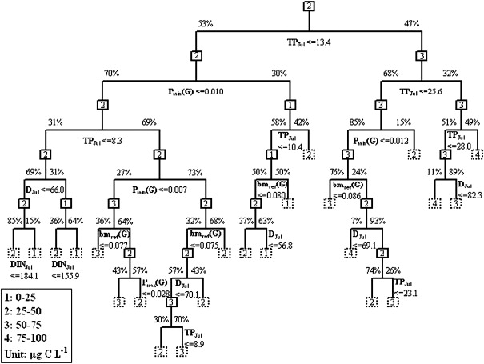
Classification Tree at a glance

Slide 7
How do Classification Trees work?
Three steps are required to obtain a good classification tree:
Creation
Pruning
Processing

Slide 8
Step 1: Creation
A binary tree is grown top-down by splitting the source set into subsets based on an attribute value test.
The best variable to use in splitting the set of items is defined by how well the variable splits the set into homogeneous subsets that have the same value of the target variable.
Different algorithms use different formulae for measuring "best“.
Example to test node impurity “the Gini coefficient”:
It reaches its minimum (zero) when all cases in the node fall into a single target category.
To compute Gini impurity for a set of items, suppose y takes on values in {1, 2, ..., m}, and let f_{i} = the fraction of items labeled with value i in the set.
The Gini index is a measure of impurity for a given node that is at a maximum when all observations are equally distributed among all classes

Slide 9
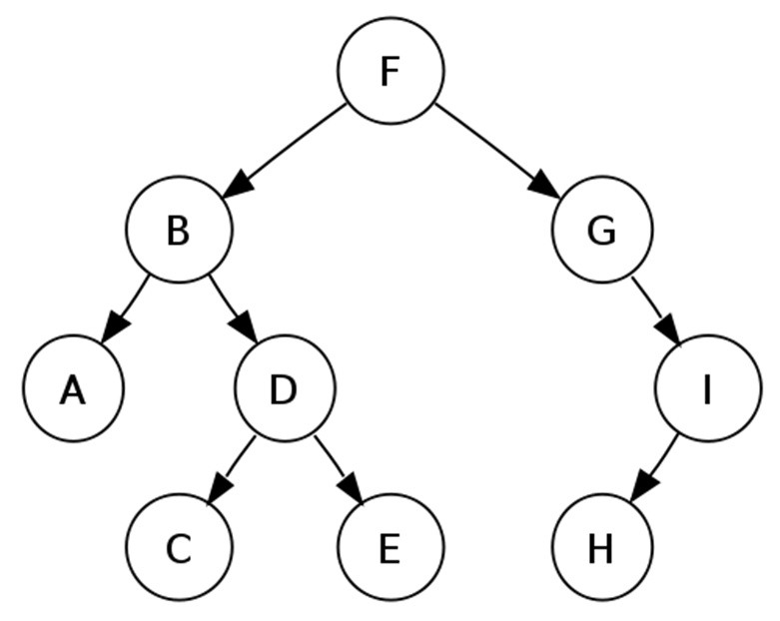
Step 1: Creation
Root node of the tree (F)
Node: a point where a branch starts or ends (A,B,C,D,E,G,H,I)
Branch: conjunction of features that lead to the labels
Leaf or terminal node: the class label (A,C,E,H)

Slide 10
Step 1: Creation
This process is repeated on each derived subset in a recursive manner (recursive partitioning).
The recursion is completed when the largest tree obtainable with the data is reached:
  each subset at a node has all the same value of the target variable, or when
  splitting no longer adds value to the predictions.
The complete tree is too large and is over-fitting the data.

Slide 11

Step 2: Pruning
Technique that reduces the size of the decision tree without reducing predictive accuracy as measured by a test set or using cross-validation.
Two fashions used to remove nodes that do not provide additional info:
  Top down ---> traverses nodes and trim sub-trees starting at the root
  Bottom up ---> starts at the leaf nodes
One of the questions that arises in a decision tree algorithm is the optimal size of the final tree.
  Too large ---> overfitting risk: poorly generalizing to new samples.
  Too small ---> not capture important structural information about the sample space.
Horizon effect problem ---> hard to tell when a tree algorithm should stop, since it is impossible to tell if the addition of a single extra node will dramatically decrease error. A common strategy is to grow the tree until each node contains a small number of instances then use pruning.
Different techniques of pruning can be implemented.

Slide 12
Step 3: Processing
Once the final tree has been created, it can be checked by using test data.
Then, the tree can be used to obtain information about new data.
At the end of the process, the characteristics of each leave can be obtained by retracing the tree from bottom to top.

Slide 13

Why Classification Trees??

Slide 14
Advantages (+) of the Classification Trees
Simple to understand and interpret ---> easy to make predictions.
Little data preparation required ---> no normalization, nor dummy variables, blank values do not need to be removed.
Flexible ---> very attractive analysis option.
Fast ---> no complicated calculations required, performs well with large data.
Robust ---> performs well even if assumptions are violated by the true model from which the data was generated.

Slide 15
Advantages (+) of the Classification Trees
Possible to validate the model through statistical tests ---> possible to account for the reliability of the model.
Solve two of the K-NN method problems:
  Similarity ---> it is now made through the response instead of the input variables
  Constant K ---> adaptive nearest-neighbor (the leaves) method

Slide 16
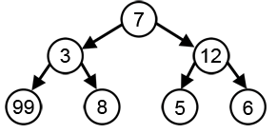
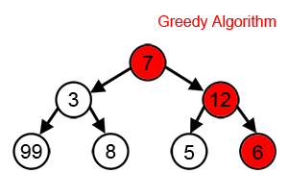
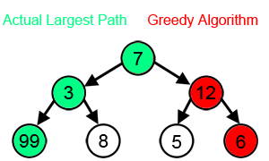
Disadvantages (-) of the Classification Trees
No globally optimal decision tree is guaranteed ---> the algorithms on which the trees are based are heuristic/greedy (=making the locally optimal choice at each stage).
Example “Reach the largest-sum”:

Slide 17
Disadvantages (-) of the Classification Trees
Over-fitting problem ---> over-complex trees might not generalize the data well; pruning mechanism needed
Biased information gain towards the attributes with more levels ---> when data is including categorical variables with different numbers of levels

Slide 18

Sum up
Classification trees are:
a good exploratory technique
a technique of last resort when traditional methods fail
According to many researchers classification trees are unsurpassed.

Slide 19
Application of the method to a simple case

Slide 20
Classification Tree Application to Simple Example: Obama-Clinton Divide
In the 2008 Democratic nomination contest:
  Obama won counties who had large African-American or highly educated populations.
  Clinton won counties dominated by whites or less educated populations.

Slide 21
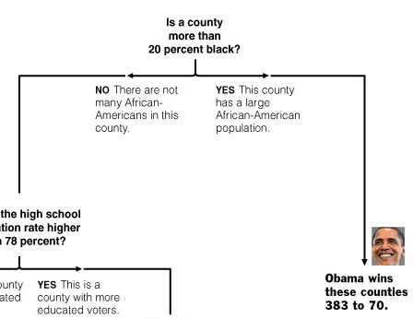
Obama-Clinton Divide
???
Source: http://www.stat.cmu.edu/~cshalizi/350/lectures/22/lecture-22.pdf

Slide 22
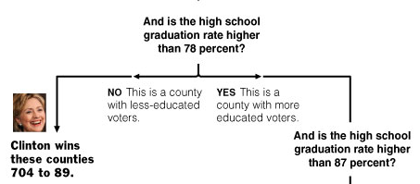
Obama-Clinton Divide
???

Slide 23
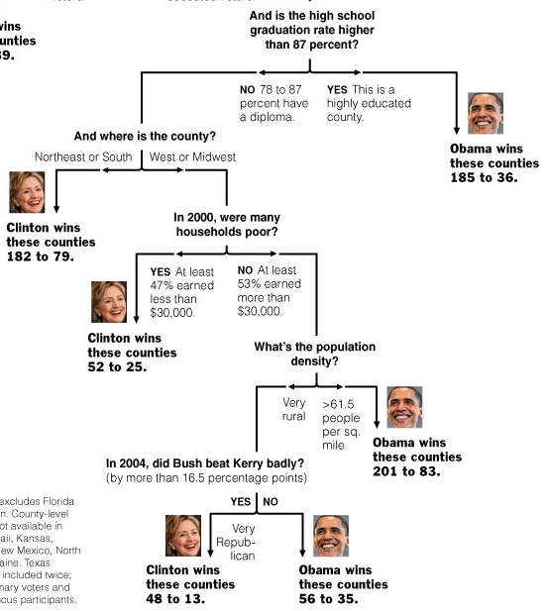
Obama-Clinton Divide

Slide 24
Real life applications of the method

Slide 25
The use of Classification Trees in Clinical Epidemiology
Used to identify high risk groups
  Branch splitting's used to create “rules”
Requires prior hypotheses of what possible attributes are
Boolean expressions (ex. A or Not A)
Source: http://ac.els-cdn.com/S0895435600003449/1-s2.0-S0895435600003449-main.pdf?_tid=22574d54-028b-11e2-a58b-00000
aacb360&acdnat=1348080917_13abd4b203eef881387a4c27639b7a17

Slide 26
Why Classification Trees?
Easy to use software
Simplicity and linearity
Common thought process with clinical decision making

Slide 27
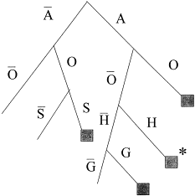
The use of Classification Trees in Clinical Epidemiology
Diabetes
  A—age over 45; O—obese; H—hypertensive; G—glucose intolerance; S—sedentary
Source: http://ac.els-cdn.com/S0895435600003449/1-s2.0-S0895435600003449-main.pdf?_tid=22574d54-028b-11e2-a58b-00000
aacb360&acdnat=1348080917_13abd4b203eef881387a4c27639b7a17

Slide 28
Problems with Classification Trees in Clinical Epidemiology
Redundant Attributes
  Obesity not required, hypertension enough

Slide 29
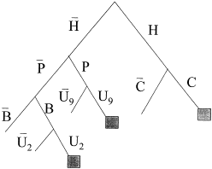
Problems with Classification Trees in Clinical Epidemiology
Questionable Relevance of links
  Links present due to way trees are constructed
Asthma
H—hospitalized during prior 6 months; C—obtained two or more medication (cromolyn) units; U₉—made nine or more urgent clinic visits; B—obtained 16 or more units of beta-agonists; U₂—made two or more urgent clinic visits; P—six or more physicians prescribe asthma medication

Slide 30
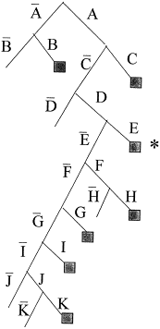
Problems with Classification Trees in Clinical Epidemiology
Mixed interactions
  No way of telling if they are true
Tooth Decay
A—primary decayed, missing, or filled (dmfs) ⩾ 5; B—morphology score ⩾ 12; C—permanent dmfs ⩾ 1; D—fissured surface ⩾ 1; E—morphology score ⩾ 11; F—age ⩾ 6.7; G—age ⩾ 6.65; H—large decay ⩾ 15; I—minimal decay ⩾ 5; J—referral score ⩾ 2; K—primary fillings ⩾ 3.

Slide 31
Analysis of the case study

Slide 32
The Case
Find people to whom it would be profitable to send more than one catalogue per year.
Donator: someone who is expected to donate more than once per year.
Assumptions:
  The shipping and production cost of a catalogue is 1 euro.
  The expected donation amount from a donator is 10 euro.

Slide 33
Descriptive Statistics
 | Mean | Median | Mode | Variance | Standard Deviation
TIMELR | 69.7907 | 48.43 | 11.43 | 0.3765 | 61.362
TIMECL | 260.9884 | 3.99 | 11.12 | 2.383 | 154.371
FRQRES | 0.4221 | 0.36 | 0.33 | 0 | 0.2491
MEDTOR | 22.2591 | 8.00 | 3.14 | 0.179 | 42.3025
AVGDON | 7.0428 | 4.44 | 5.00 | 0.0116 | 10.7767
LSTDON | 16.8018 | 10.00 | 10.00 | 0.0278 | 16.666
ANNDON | 15.2021 | 9.00 | 0.90 | 0.0551 | 23.4629
DONAMT | 6.2327 | 0.00 | 0.00 | 0.0195 | 13.9517
DONIND | 0.3473 | 0.00 | 0.00 | 0 | 0.4762

Slide 34
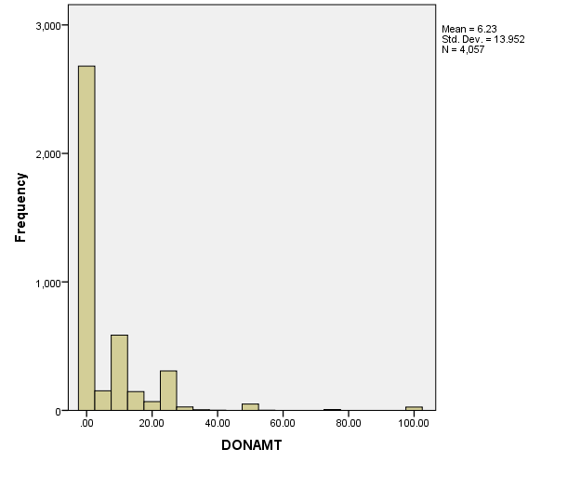
Histogram

Slide 35
Correlation Matrix
 | TIMELR | TIMECL | FRQRES | MEDTOR | AVGDON | LSTDON | ANNDON | DONAMT | DONIND
TIMELR | 1 | -0.0631 | -0.7379 | -0.1065 | -0.3130 | -0.0542 | -0.3137 | -0.2639 | -0.4137
TIMECL | -0.0631 | 1 | 0.0681 | 0.0653 | 0.0609 | 0.0337 | -0.1641 | 0.1166 | 0.1263
FRQRES | -0.7379 | 0.0681 | 1 | -0.0206 | 0.3936 | -0.0163 | 0.3769 | 0.2738 | 0.4662
MEDTOR | -0.1065 | 0.0653 | -0.0206 | 1 | 0.0337 | 0.0894 | 0.0232 | 0.0204 | 0.0008
AVGDON | -0.3130 | 0.0609 | 0.3936 | 0.0337 | 1 | 0.6178 | 0.9020 | 0.4995 | 0.1987
LSTDON | -0.0542 | 0.0337 | -0.0163 | 0.0894 | 0.6178 | 1 | 0.6036 | 0.3956 | 0.0115
ANNDON | -0.3137 | -0.1641 | 0.3769 | 0.0232 | 0.9020 | 0.6036 | 1 | 0.4339 | 0.1755
DONAMT | -0.2639 | 0.1166 | 0.2738 | 0.0204 | 0.4995 | 0.3956 | 0.4339 | 1 | 0.6125
DONIND | -0.4137 | 0.1263 | 0.4662 | 0.0008 | 0.1987 | 0.0115 | 0.1755 | 0.6125 | 1

Slide 36
Step 1: Construction
Variables/ Response:
  DONIND – factor
  TIMELR – integer
  TIMECL – integer
  FRQRES – numeric
  AVGDON – double
  ANNDON – double

Slide 37
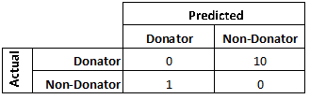
Step 1: Construction
First tree is grown without weights
Cost matrix:
Hence, second tree is grown with weights 0:1=1:10

Slide 38
Step 2: Pruning
K---> the cost complexity parameter
Best ---> integer requesting the size of a specific sub-tree in the cost complexity sequence
To prune the tree we used the cost complexity factor.

Slide 39
The Complexity Parameter
The complexity parameter (cp) is used to control the size of the decision tree and to select the optimal tree size. If the cost of adding another variable to the decision tree from the current node is above the value of cp, then tree building does not continue.

Slide 40
The Complexity Parameter
BEST: integer requesting the size of a specific subtree in the complexity sequence to be returned. This is an alternative way to select a subtree than by supplying a scalar complexity parameter. If there is no tree in the sequence of the requested size, the next largest is returned.

Slide 41
The Complexity parameter
The complexity sequence is the sequence of subtrees minimizing the complexity measure. You can give a value k for the complexity parameter, but in our case it has been determined algorithmically

Slide 42
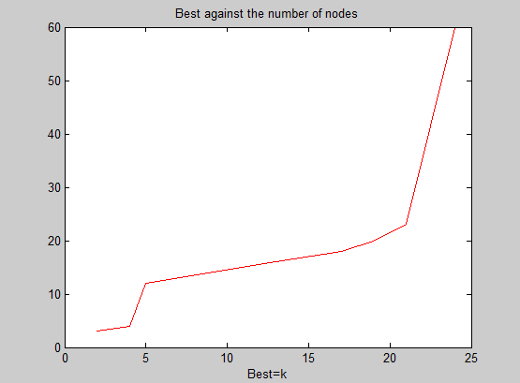
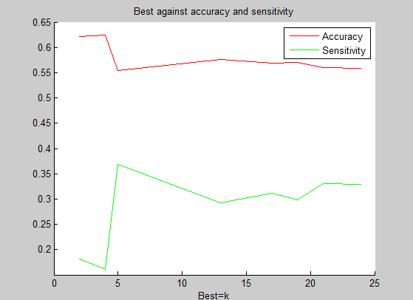
Step 2: Pruning – No Weights

Slide 43
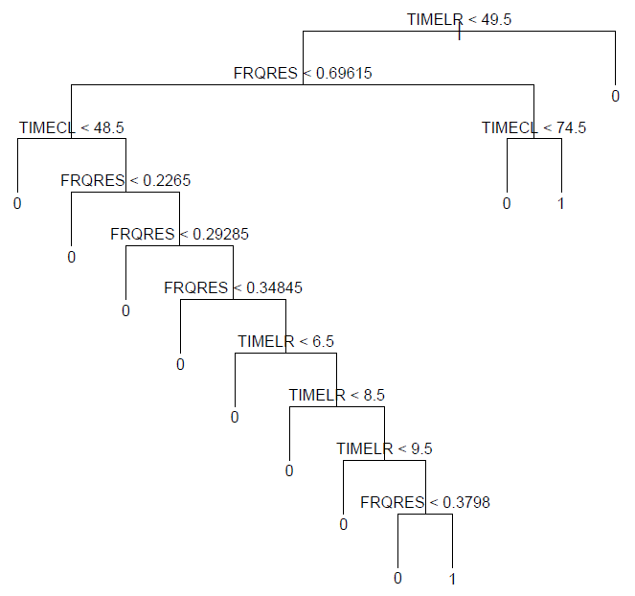
Pruned Tree without weights at a glance

Slide 44
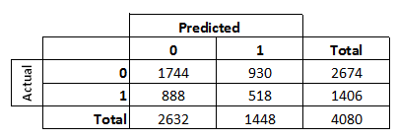
Classification Matrix
Sensitivity: 0.3286
Accuracy: 0.5598
Percentage of respondents: 0.3577

Slide 45
Lift Chart Tree without weights
% Resopondents | % Donations
0.0000 | 0.0000
0.1000 | 0.0946
0.2000 | 0.1899
0.3000 | 0.2983
0.4000 | 0.4109
0.5000 | 0.5124
0.6000 | 0.6153
0.7000 | 0.7134
0.8000 | 0.8046
0.9000 | 0.9012
1.0000 | 1.0000

Slide 46
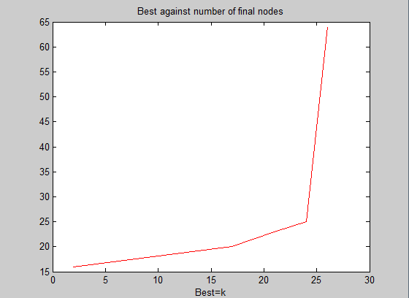
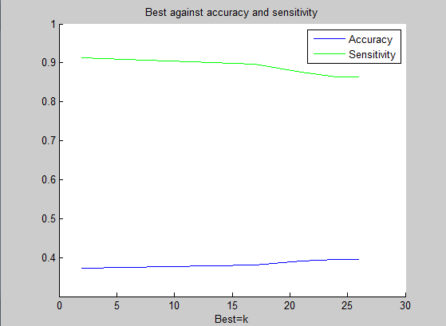
Step 2: Pruning – With Weights

Slide 47
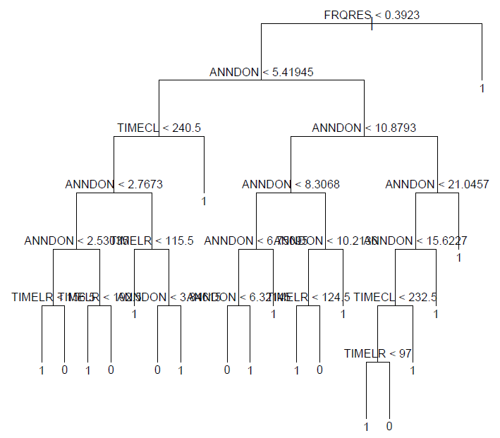
Pruned Tree with weights at a glance

Slide 48
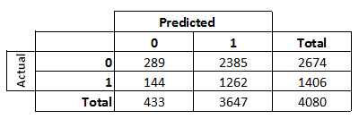
Classification Matrix
Sensitivity: 0.8976
Accuracy: 0.3801
Percentage of respondents: 0.3460

Slide 49
Lift Chart Tree with weights
% Respondents | % Donations
0.0000 | 0.0000
0.1000 | 0.1012
0.2000 | 0.2015
0.3000 | 0.3019
0.4000 | 0.4022
0.5000 | 0.5001
0.6000 | 0.6043
0.7000 | 0.7047
0.8000 | 0.8037
0.9000 | 0.9016
1.0000 | 1.0000

Slide 50
Conclusion
Profit function:
second catalogue profit
= 10 * number of respondent – number of catalogues sent

Slide 51
Quantifying
Classification Tree profit:
No weights = 518*10 – 1,448*1=3,732 euro
Weights = 1,262*10 – 3,647*1= 8,973 euro
Naive approach profit:
  35% donators (65% non-donators)
  4081 catalogues sent (test data)
  Profit = 1,406*10 - 4081*1=9,979 euro

Slide 52
Further suggestions

Slide 53
Further Suggestions: Questionnaire
Send a questionnaire along with the catalogue with questions referring to the private life of the donator (e.g. social status, family status, age…).
It could be of help in identifying the donator “type” ---> the catalogue could be sent to other people who fulfill the donator-type’s characteristics, but are not members of the organization yet.

Slide 54
Further Suggestions: Catalogue Differentiation
During the year different booklets could be sent to the donators.
Example:
1st catalogue: general information about the organization’s plan of the year.
2nd catalogue: thanking the donator and update him/her with what has been done so far, hoping for further improvements in the cause.
3rd catalogue: acknowledging the sacrifice that the donator has been doing during the year, but hoping for even more astonishing improvements thanks to the donations.

Slide 55


Questions??

Slide 56
Thank you for your attention!!!

