Slide 1
K-nearest neighbor & Naive Bayes
27-09-2012
Data mining
Sven Kouwenhoven
Adam Swarek
Chantal Choufoer

Slide 2
General Plan
Part 1
Discuss K-nearest neighbor & Naive Bayes
1 Method
2 Simple example
3 Real life example
Part 2
Application of the method to the Charity Case
Information about the case
Pre-analysis of the data
1 Data visualization
2 Data reduction
Analysis
1 Recap of the method
2 How do we apply the method to the case
3 The result of the model
4 Choice of the variables
5 Conclusion and recommendations for the client
Conclusion

Slide 3
Part 1
Discuss K-nearest neighbor & Naive Bayes

Slide 4
K-NN
K – nearest neighbors

Slide 5
General info
You can have either numerical or categorical outcome – we focus on categorical (classification as opposed to prediction)
Non-parametric - does not involve estimation of parameters in a function form
      In practice – it doesnt give you a nice equation that you can apply readily, each time you have to go back to the whole dataset.

Slide 6
K-NN – basic idea
„K” stands for the number of nearest neighbours you want to have evaluated
„Majority vote” – You evaluate the „k” nearest neighbors and count which label occurs more frequently and you choose this label

Slide 7
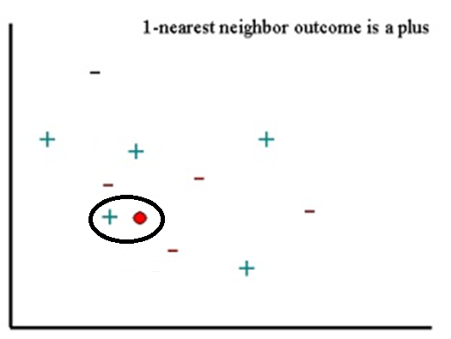

Slide 8
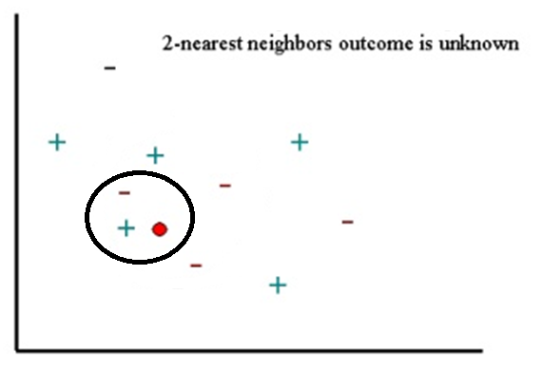

Slide 9
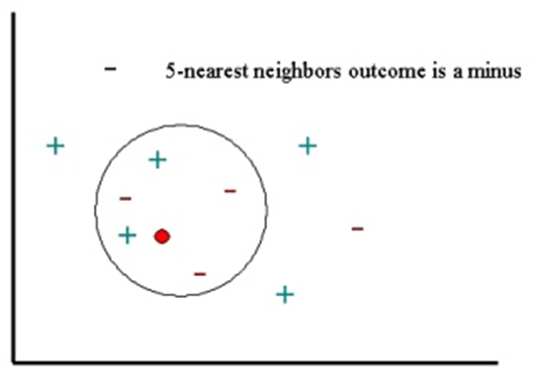

Slide 10

Which one actually is the nearest neghbour?
The one that basically is the closest - most frequently euclidean distance used to measure it:
      p –
      X –
      U -
A lot of other variations
E.g
  Different weights
  Other types of distance measures

Slide 11
How to choose K ?
No single way to do this
Not too high
  Otherwise you will not capture the local structure of data, which is one of the biggest advantages of k-nn
Not too low
  Otherwise you will capture the noise in the data .
So what to do ?
Play with different values of k and see what gives you the most satisfying result
Avoid the values of k and multiples of kthat equal the number of possible outcomes of the predicted variables

Slide 12

Probability of given outcome
It is also possible to calculate probability of the given outcome basing on k-nn method
You simple take k nearest neighbors and count how many of them are in particular class and then the probability of a new record to belong to the class is the count number divided by k

Slide 13
PROS vs CONS
PROS:
  + Conceptual simplicity
  + Lack of parrametric assumptions
  no time required to estimate parameters from training data
  + Captures local structure of dataset
  + Training Dataset can be extended easily
  as opposed to parametric models, where probably new parameters would have to be developed or at least model would need testing

Slide 14
CONS
- No general model in the form of eqation is given – each time we want to test the new data, the whole dataset has to be analyzed (slow) – processing time in large data set can be unacceptable
but:
- reduce directions
- find „almost nearest neighbor” – sacrifice part of the accuracy for processing speed
- Curse of dimensionality – data needed increases exponentially with number of predictors. ( large dataset required to give meaningful prediction )

Slide 15
Real life examples of k-nn method

Slide 16
Examplary uses
Nearest Neigbor based content retrieval ( in general product reccomandation )
- Amazon
- detailed ex. - Pandora
2. Biological uses
- Gene expression
- Protein- Protein interaction
Source: http://saravananthirumuruganathan.wordpress.com/2010/05/17/a-detailed-introduction-to-k-nearest-neighbor-knn-algorithm/
http://bionicspirit.com/blog/2012/01/16/cosine-similarity-euclidean-distance.html

Slide 17

Detailed ex: Pandora

Slide 18
How does it work ? (simplified)
Every song is assessed on hundreds of variables on scale from 0-5 by musicians
Each song is assigned a vector consisting of results on each variable
The user of the Radio chooses the song he/she likes ( the song has to be in Pandora’s database)
The program gives the suggested next song that would appeal ( based on the k-nn classification) to the taste of the person
The user marks as either „like” or „dislike” - the system keeps the information and can give another suggestion ( now based on the average of two liked songs ) of a song
The process follows and the program can give a better suggestion everytime.

Slide 19
Introduction to the method
Naive Bayes
Classification method
Maximize overall classification accuracy
Identifying records belonging to a particular class of interest
      ‘Assigning to the most probable class’ method
      Cutoff probability method

Slide 20
Introduction to the method
Naive Bayes
‘Assigning to the most probable class’ method
1 Find all the other records just like it
2 Determine what classes they all belong to an which class is more
prevalent
3 Assign that class to the new record

Slide 21
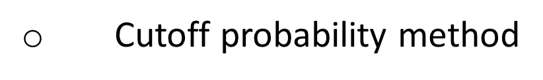
Introduction to the method
Naive Bayes
1 Establish a cutoff probability for the class of interest above which we consider that a record belongs to that class
2 Find all the training records just like the new record
3 Determine the probability that those records belong to the class of interest
4 If that probability is above the cutoff probability, assign the new record to the class of interest

Slide 22
Introduction to the method
Naive Bayes
Class conditional probability
Bayes Theorem: Prob(A given B) →
A represents the dependent event and B represents the prior event.
* Bayes’ Theorem finds the probability of an event occurring given the probability of another event that has already occurred
Notes:
8.3 formule neerzetten

Slide 23
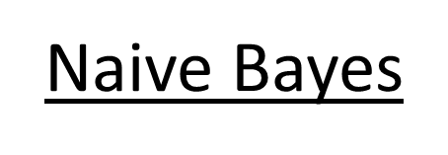
Introduction to the method
P(Ci|x1,….,xp) ; The probability of the record belonging to class i given that its predictor values take on the values x1,….xp
Pnb (c1|x1,….,x2) =

Slide 24
Introduction to the method
Naive Bayes
Categorical predictors: The Bayesian classifier works only with categorical predictors
If we use a set of numerical predictors, what will happen?
Naive rule: assign all records to the majority class

Slide 25
Introduction to the method
Naive Bayes
Advantages
Good classification performance
Computationally efficient
Binary and multiclass problems
Disadvantages
Requires a very large number of records
When the goal is estimating probability instead of classification, then the method provides a very biased results

Slide 26
Naive Bayes classifier case the training set
Day | Outlook | Temperature | Humidity | Wind | Play Tennis?
1 | Sunny | Hot | High | Weak | No
2 | Sunny | Hot | High | Strong | No
3 | Overcast | Hot | High | Weak | Yes
4 | Rain | Mild | High | Weak | Yes
5 | Rain | Cool | Normal | Weak | Yes
6 | Rain | Cool | Normal | Strong | No
7 | Overcast | Cool | Normal | Strong | Yes
8 | Sunny | Mild | High | Weak | No
9 | Sunny | Cool | Normal | Weak | Yes
10 | Rain | Mild | Normal | Weak | Yes
11 | Sunny | Mild | Normal | Strong | Yes
12 | Overcast | Mild | High | Strong | Yes
13 | Overcast | Hot | Normal | Weak | Yes
14 | Rain | Mild | High | Strong | No
P(Play_tennis) = 9/14
P(Don’t_play_tennis) = 5/14

Slide 27
Naive Bayes classifier case the training set
Day | Outlook | Temperature | Humidity | Wind | Play Tennis?
1 | Sunny | Hot | High | Weak | No
2 | Sunny | Hot | High | Strong | No
3 | Overcast | Hot | High | Weak | Yes
4 | Rain | Mild | High | Weak | Yes
5 | Rain | Cool | Normal | Weak | Yes
6 | Rain | Cool | Normal | Strong | No
7 | Overcast | Cool | Normal | Strong | Yes
8 | Sunny | Mild | High | Weak | No
9 | Sunny | Cool | Normal | Weak | Yes
10 | Rain | Mild | Normal | Weak | Yes
11 | Sunny | Mild | Normal | Strong | Yes
12 | Overcast | Mild | High | Strong | Yes
13 | Overcast | Hot | Normal | Weak | Yes
14 | Rain | Mild | High | Strong | No

Slide 28
OUTLOOK | Play = Yes | Play = No
Sunny | 2/9 | 3/5
Overcast | 4/9 | 0/5
Rain | 3/9 | 2/5
TEMPERATURE | Play = Yes | Play = No
Hot | 2/9 | 2/5
Mild | 4/9 | 2/5
Cool | 3/9 | 1/5
HUMIDITY | Play = Yes | Play = No
High | 3/9 | 4/5
Normal | 6/9 | 1/5
WIND | Play = Yes | Play = No
Strong | 3/9 | 3/5
Weak | 6/9 | 2/5

Slide 29
Case:
Should we play tennis today?
Today the outlook is sunny, the temperature is cool, the humidity is high, and the wind is strong.
X = (Outlook=Sunny, Temperature=Cool, Humidity=High, Wind=Strong)

Slide 30
OUTLOOK | Play = Yes | Play = No
Sunny | 2/9 | 3/5
Overcast | 4/9 | 0/5
Rain | 3/9 | 2/5
TEMPERATURE | Play = Yes | Play = No
Hot | 2/9 | 2/5
Mild | 4/9 | 2/5
Cool | 3/9 | 1/5
HUMIDITY | Play = Yes | Play = No
High | 3/9 | 4/5
Normal | 6/9 | 1/5
WIND | Play = Yes | Play = No
Strong | 3/9 | 3/5
Weak | 6/9 | 2/5

Slide 31
Results for playing
P(Outlook=Sunny | Play=Yes) =X₁ = 2/9
P(Temperature=Cool | Play=Yes) = X₂ = 3/9
P(Humidity=High | Play=Yes) = X₃ = 3/9
P(Wind=Strong | Play=Yes) = X₄ = 3/9
P(Play=Yes) = P(C_{Y}) = 9/14

Slide 32
Numerator of naive Bayes equation
P(X₁|C_{Y})* P(X₂|C_{Y})* P(X₃|C_{Y})* P(X₄|C_{Y})*P(C_{Y})=
(2/9) * (3/9) * (3/9) * (3/9) * (9/14) = 0.0053
0.0053 represents P(X₁,X₂,X₃,X₄|C_{Y})*P(C_{Y}), which is the top part of the naive Bayes classifier formula

Slide 33
Results for not playing
P(Outlook=Sunny | Play=No) = X₁ = 3/5
P(Temperature=Cool | Play=No) = X₂ = 1/5
P(Humidity=High | Play=No) = X₃ = 4/5
P(Wind=Strong | Play=No) = X₄ = 3/5
P(Play=No) = P(C_{N}) = 5/14
(3/5) * (1/5) * (4/5) * (3/5) * (5/14) = 0.0206

Slide 34
Summary of the results so far
For playing tennis, P(X₁,X₂,X₃,X₄|C_{Y})P(C_{Y}) = 0.0053
For not playing tennis P(X₁,X₂,X₃,X₄|C_{N})P(C_{N}) = 0.0206

Slide 35
Denominator of naive Bayes equation
Evidence =
P(X₁,X₂,X₃,X₄|C_{Y})*P(C_{Y}) + P(X₁,X₂,X₃,X₄|C_{N})*P(C_{N})
= 0.0053 + 0.0206 = 0.0259

Slide 36
Answer:
The probability of not playing tennis is larger so we should not play tennis today.

Slide 37
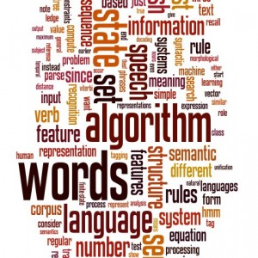
Real life example of Naive Bayes method

Slide 38
Examplary uses
  Text classifications
  Spam filtering in E-mails
  Text processors – errors correction
  Detecting the language of the text
  http://bionicspirit.com/blog/2012/02/09/howto-build-naive-bayes-classifier.html
  Metereorology ( CALIPSO , PATMOS-x)
  http://journals.ametsoc.org/doi/pdf/10.1175/JAMC-D-11-02.1
  Plagiarism detection

Slide 39
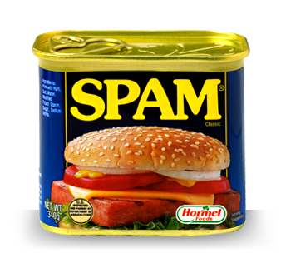
Detailed ex: SPAM FILTERING

Slide 40
How does it work ?
Humans classify a huge amount of e-mails as spam or not spam, and then select equal training dataset of spam and non-spam emails.
For each word compute the frequency of occurance in spam and non-spam e-mails and attach probability of occurance of a word in spam as well as non-spam e-mail
Then apply the naive bayes probability of belonging to the class ( spam or not spam )
Eihter the simple higher probability method or a cutoff threshold method to classify.
Additional – if you for example classify the e-mails in your e-mail client for spam and non spam, then you also create a personalized spam filter.

Slide 41
Break!

Slide 42
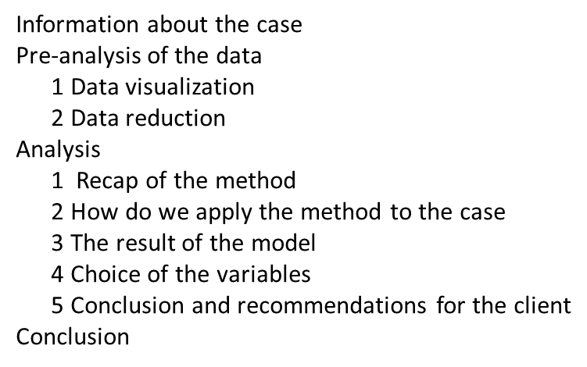
Part 2
Application of the method to the charity case

Slide 43
General Introduction of the case
Dutch charity organization that wants to be able to classify it's supporters to donators and non-donators.
Goal of the charity organization
- how will they meet the goal?
→ Effective marketing : more direct marketing to highly potential customers

Slide 44
General Introduction of the case
Variable:
TimeLr → Time since last response
TimeCl → Time as client
FrqRes → Frequency of response
MedTOR → Median of time response
AvgDon → Average donation
LstDon → Last donation
AnnDon → Average annual donation
DonInd → Donation indicator in the considered mailing

Slide 45
General Introduction of the case
The sample of the training data consist of 4057 customers
The sample of the test data consist of 4080 customers

Slide 46
General Introduction of the case
Assumptions
Sending cost of the catalogue: € 0.50
Catalogue cost: € 2.50
Revenue of sending a catalogue to a donator: € 18,-

Slide 47
Application of the case
Evaluating performance
Classification matrix
Summarizes the correct and incorrect classifications that a classifier produced for a certain dataset
Sensitivity → ability to detect the donators correctly
- Specificity → ability to rule out non-donators correctly
Lift chart
X-axis → cumulative number of cases
Y-axis → cumulative number of true donators

Slide 48
2. Data Visualisation

Slide 49
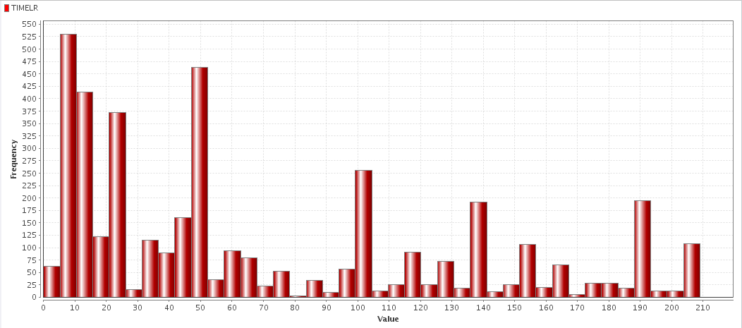
Histogram for attribute TIMELR
Y-axis: Number of people who donated
X-axis: Time since last response in WEEKS

Slide 50
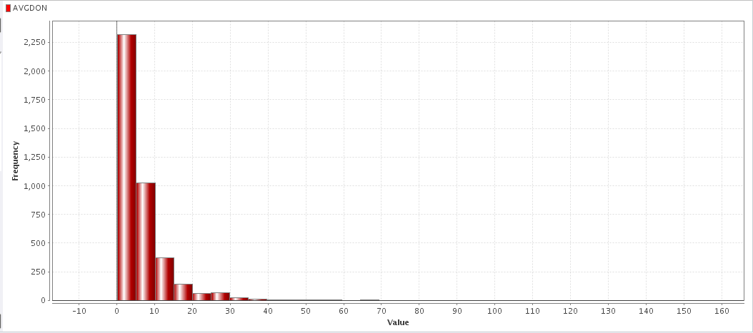
Histogram for attribute AVGDON
Y-axis: Number of people who donated
X-axis: Average amount that people donated

Slide 51
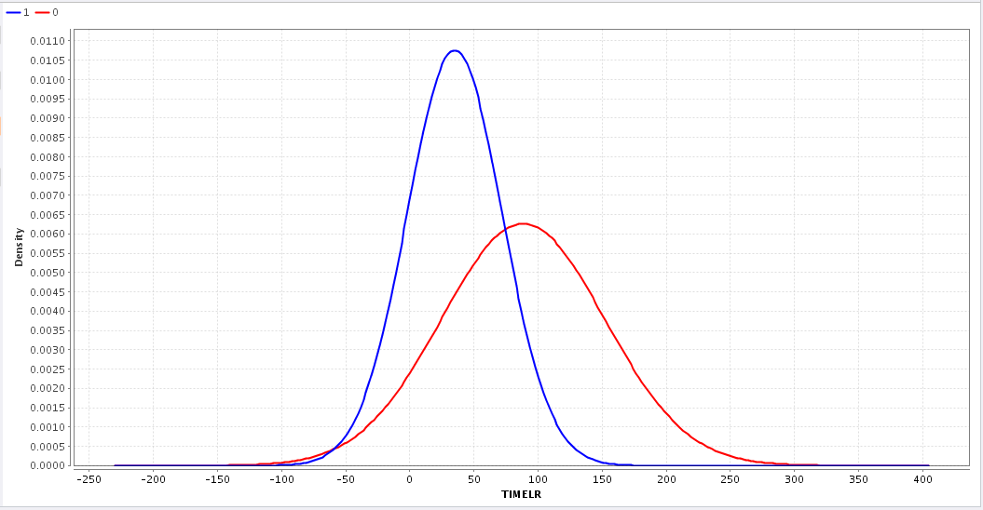
Distribution for attribute TIMELR
This distribution shows not so much overlap: good to distinguish between classes.

Slide 52
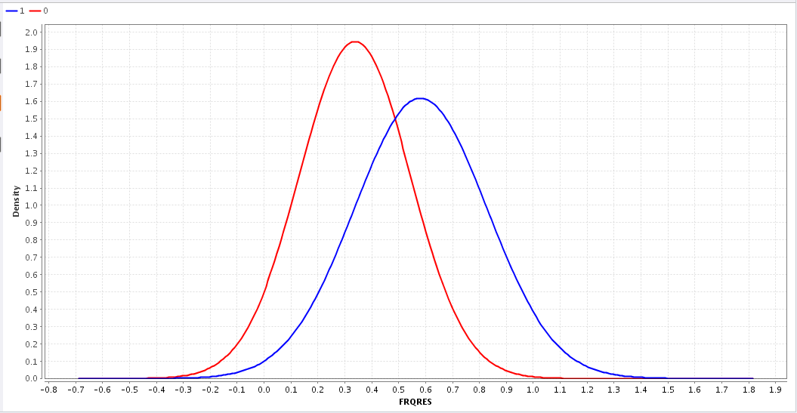
Distribution for attribute FRQRES

Slide 53
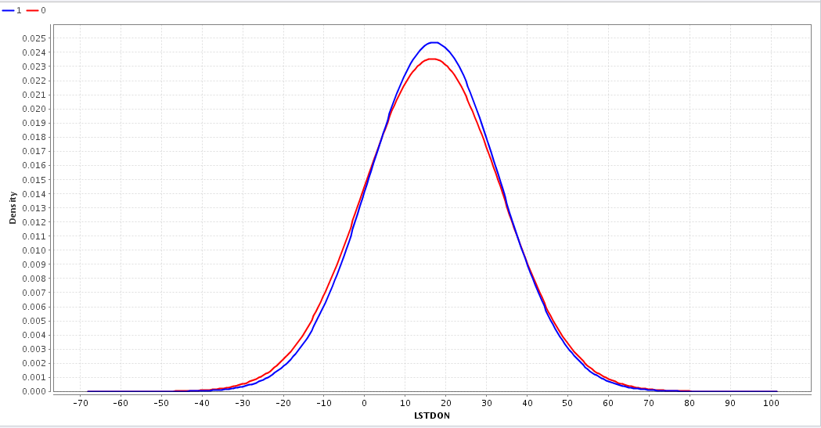
Distribution for attribute LSTDON
This distribution shows much overlap

Slide 54
Outliers

Slide 55
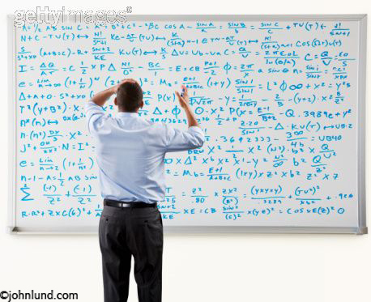

Slide 56
1 outlier

Slide 57


Slide 58
What do we do with it ?
  We decided to leave this variable in the training dataset.
  Furthermore, we advice that this individual is inspected in more detail, to understand why he donates so much.

Slide 59
PCA
Performance component analysis

Slide 60
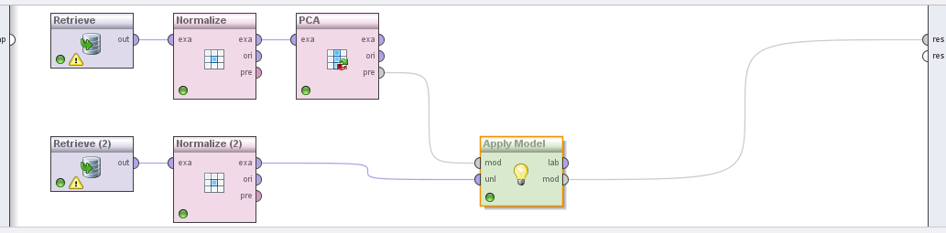
RAPIDMINER WAY ☺

Slide 61
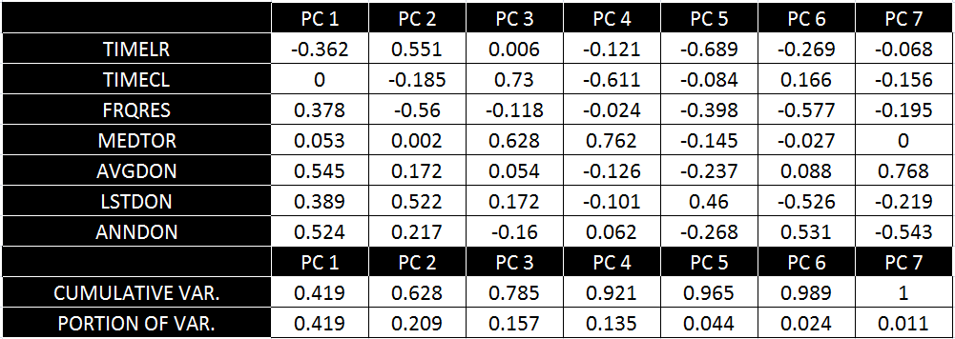
PCA MATRIX
(i hope sth like this exists)
Resulting table ( with a little bit of editing from me for you ;) )

Slide 62
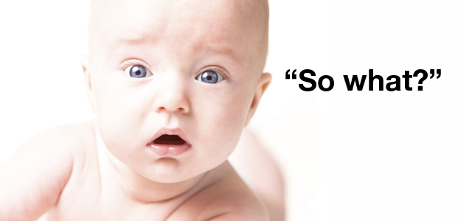

Slide 63
A few conclusions:
4 PCA’s catch 92.1 % of data, 5 PCA’s catch 96.5%
It is sometimes possible that PCA’s combine to give some variable that is not measured directly – we do not think it is the case in this example – each PCA consists of too many variables.
We will test the methods with PCA’s as well

Slide 64
Correlation table
Steps

Slide 65
IMPORTANT NOTE
Remember to normalize
- most of the programms do it automatically but always make sure that you do it.

Slide 66
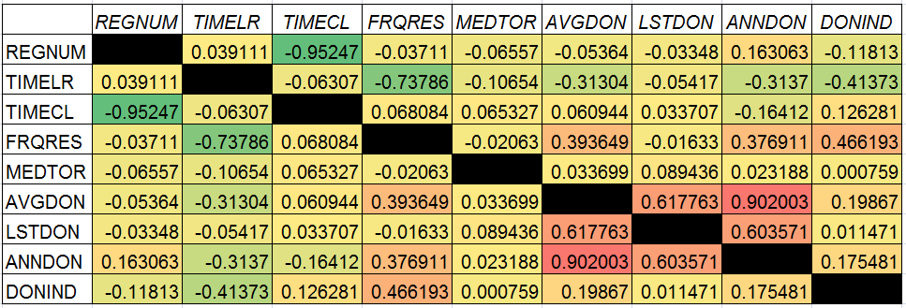
Correlation table

Slide 67
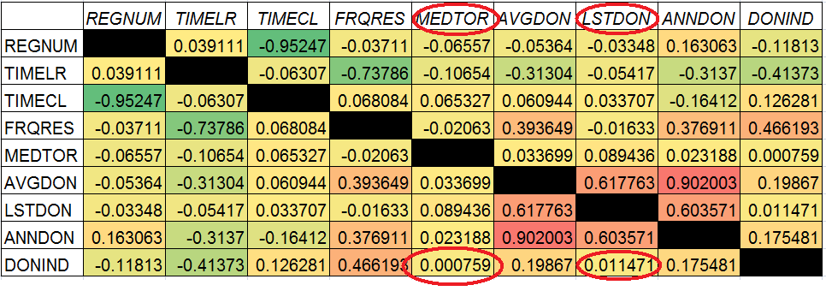
Remove those attributes that do not explain your target attribute ( small correlation with DONIND )

Slide 68
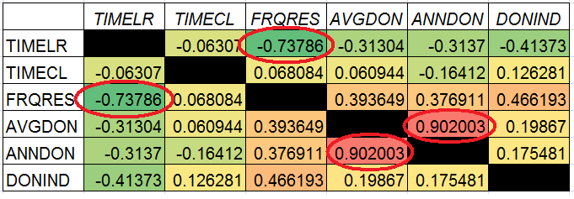
Look for variables that correlate a lot

Slide 69
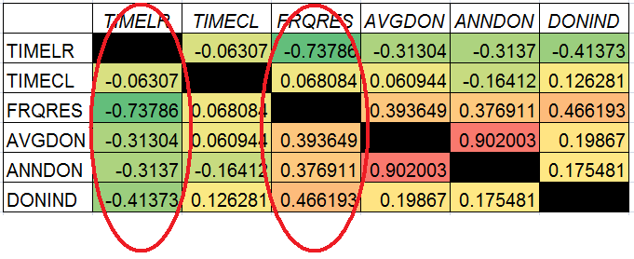
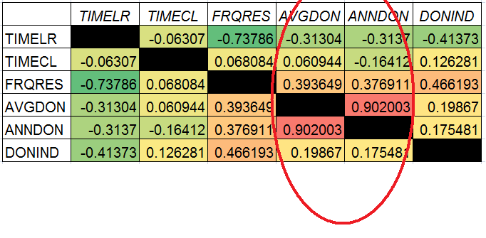
You can double check if they also correlate on other variables a lot.

Slide 70
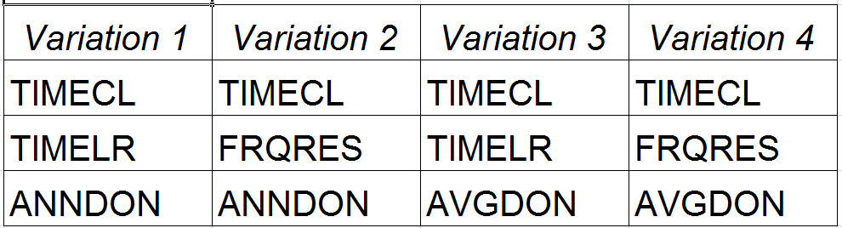
We are left with only 3,4 or 5 variables
TIMECL
TIMELR or FRQRES
ANNDON or AVGDON

Slide 71
Decide which variation is best ?
HOW ?
2 options

Slide 72
Option 1
Guess ( intuition )
  + Quick
  - Not really reliable

Slide 73
Option 2
Check your model with different combinations of variables
  + More reliable and accurate results
  - Time-consuming
Unfortunately, we’ve chosen this one ;)

Slide 74
Some conclusions after data reduction ?
  Median of time of response as well as the amount of last donation poor indicators of classifying for donator/non-donator ( we shouldn’t look at those when deciding if the person should be sent a catalogue )
  Frequency of response is highly correlated with time since last response – It means we have a group of people that donate regularly and they also donated not a long time ago, but ( more logical ) It means that the higher the frequency of the response the bigger chance that you replied to the mailing lately ;) ( quite logical if you think about it )
  Average donation per responded mail has very high correlation with Annual average donation ( it means that people on average donate once in a year )

Slide 75
Application of k-nn method to the charity case

Slide 76
First
A tricky question for you:
What results do we want from the method ? What makes the method suitable ?
High accuracy ?
Not necessarily… follow the application of the method on the next page

Slide 77
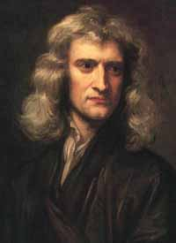
Smart
hihihihi
            I have great idea for a model that will have pretty good accuracy and is extremely easy to apply
            Lets set k=4000
            Other words…
            Lets make a model where we assign all the guys as nondonators.
            Lets see what happens…

Slide 78
What is wrong with this method ?
Well accuracy isnt so bad at all : 65.57 %
      ( I was able to get up to 72% with all the complex data reduction, pca, correlation matrix, different k’s values computations and staff like this )
So what is wrong with the model ?
  It has no value for our client !
  But why ?
      Tip : It never misses any of non-donators
      Well it doesnt help to find who a donator is neither

Slide 79
What does our client want to know !!!
The basic question is:

Slide 80
What precisely ?
Either to save or earn him money
How do we do it in this case ?
  Find the point where the incemental profit of the catalogue is zero
  In Other words help to send catalogues as long as:
    (probability of charity org. getting a donation)X (Average donation) – sending catalogues cost> 0
    Gain of the client is (those who werent sent the catalog)x(sending catalog cost)

Slide 81
We want the model that will be accurate
Even more important, we want to predict highest possible number of donators

Slide 82
How do we apply k-nn to charity case ?
Try out different variations of variables :
    Correlation matrix
    PCA
Try out different values of k
Compare accuracy of different variations
Compare the ability to „catch” the donators ( percentage of donators predicted )

Slide 83
We tested for all of these combinations ( also different k’s
PCA
  3 PCA’s
  4 PCA’s
  5 PCA’s
3 variables ( 4 combinations )
4 variables ( 2 combinations )
5 variables ( 1 combination )

Slide 84
I might give you details but….
We are limited by time… ;)
And….
It is possible that it would be boring …

Slide 85
A few more words about application:
I will show you the results for 2 variations of variables :
  5 PCA’S
  4 variables ( namely – TIMELR,TIMECL,FRQRES,AVGDON)
  4 variables give the most satisfying result
      Measured as the trade-off between accuracy and percentage of 1’s predcited

Slide 86
What will we do ?
Compare accuracy for different values of k
Compare number of 1’s predicted for different values of k.
Lift charts to visualize best values of k from the two sets of variables

Slide 87
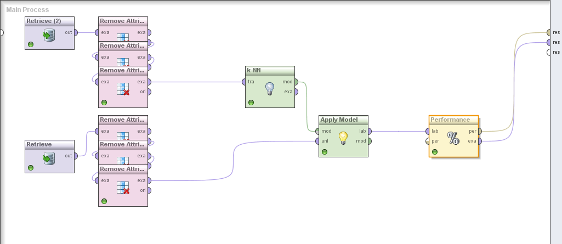
Rapidminer ( 4 variables )

Slide 88
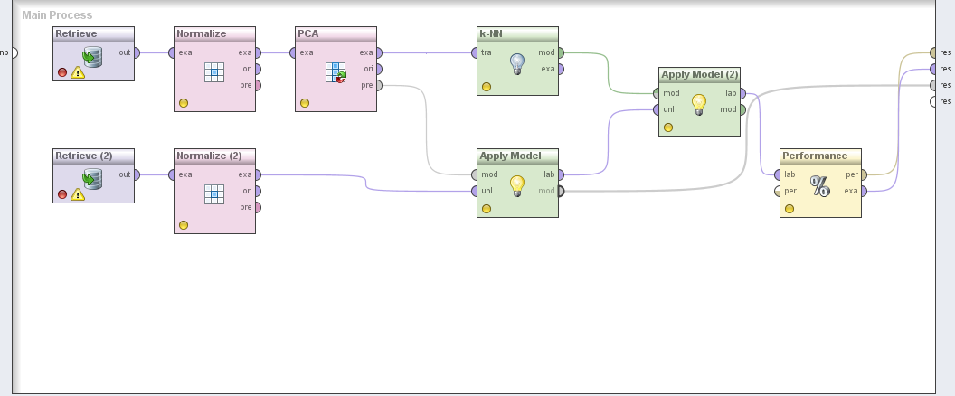
Rapidminer ( 5 PCA’s )

Slide 89
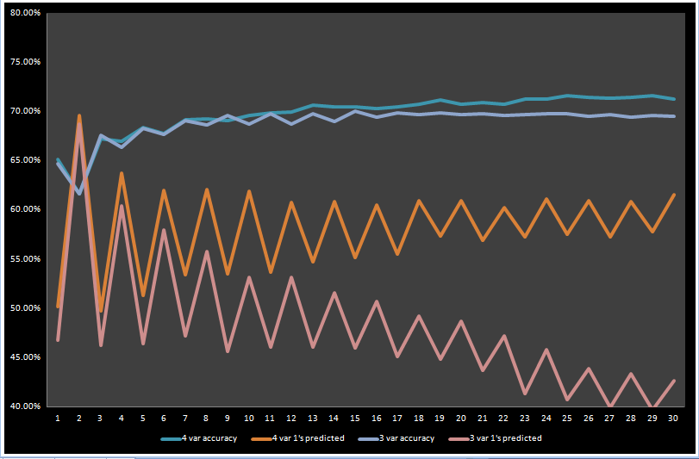
Results for differeny values of k
(3 variables and 4 variables)

Slide 90
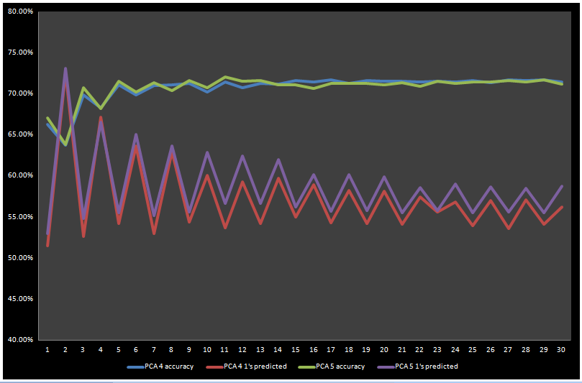
Results for differeny values of k
(4 PCA’s and 5 PCA’s)

Slide 91
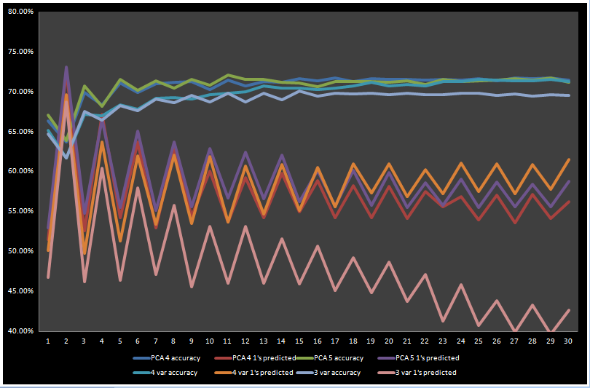
4 combinations

Slide 92
Final choice of K
K= 12 for both
Easy computation for break-even point
Relatively little differences in accuracy and sensitivity
K=2 → highest senistivity, but it is rather the noise in the data then real accuracy

Slide 93
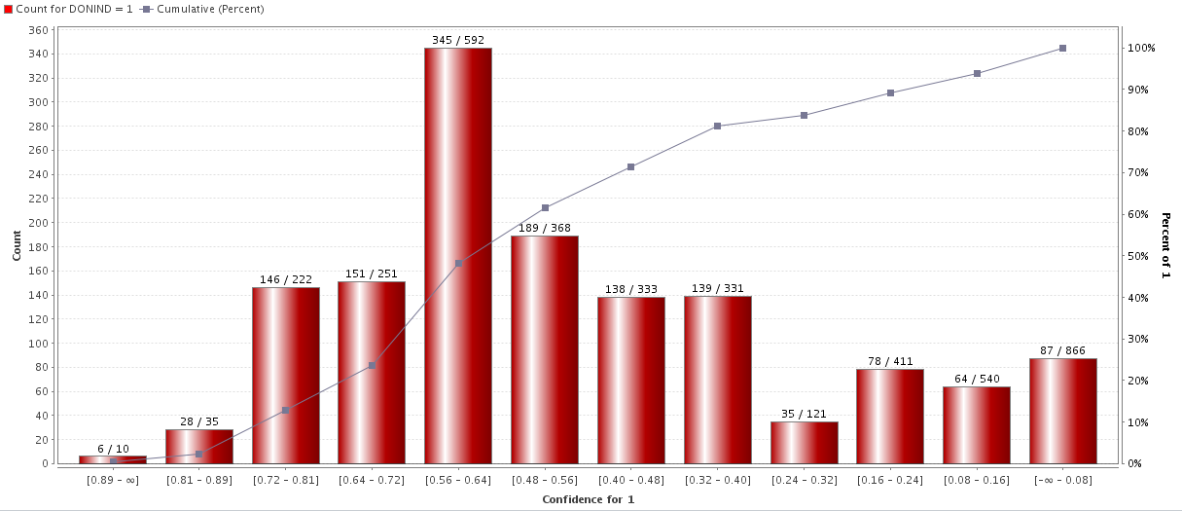
Lift chart ( 4 variables )

Slide 94
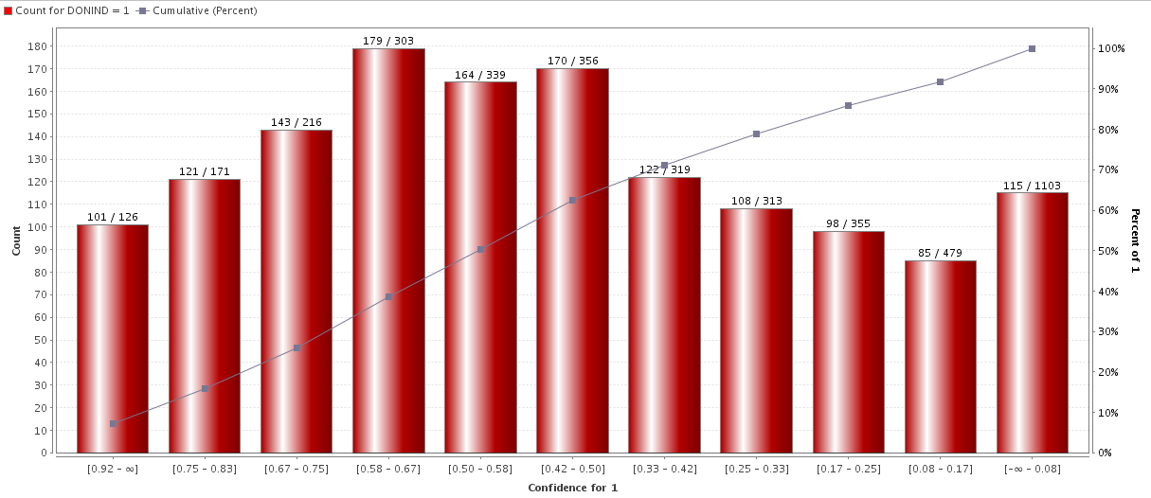
Lift chart ( 5 PCA’s )

Slide 95
Which set of variables better ?
5 PCA’s
  Better performance
  Less intuitive to predict outcome
4 variables
  More intuitive
  Worse performance
The best option is to use both sets, one to predict the outcome, the other one to give intuitive understanding

Slide 96
How do we calculate what we earn ?
I mentioned it earlier,
There must be a point in the dataset, where the cost of sending a catalogue is bigger than the incremental profit

Slide 97
3 Scenarios
Scenerio 1 – we send catalogue to all clients.
Scenario 2 – We send catalogue to those that were classified as donators with the method.
Scenario 3 – We send catalogue to those that it pays off according to incremental profit.

Slide 98
Scenario 1
Profit:
Profit = 1406* € 18 – (4080* € 3)= € 13068

Slide 99
Scenario 2
Case 1 - 4 variables and Case 2 -5 PCA’s )
Case 1 ( Predicted 1s : 1478 true 1s: 865 )
  865* € 18 – (1478* € 3) = € 11136
Case 2 ( Predicted 1s : 1511 true 1s:878 )
878* € 18 – (1511* € 3) = € 11271

Slide 100
Scenario 3
Step 1 – calculate probability so that:
  P x (Revenue) – Cost < 0
  ( cost of sending catalouge is less then expected revenue )
  Px18 – 3 = 0
  P = 0.167

Slide 101
Scenario 3
Step 2 ( apply to both combinations )
  We send catalogues to those that have the probability of being a donator 0.167 or higher (check the lift chart)
  Case 1 ( catalogues sent:2674 donators:1255
  1260* € 18 – (2674* € 3) = € 14568
  Case 2 ( catalogues sent:2498 donators:1206
  1206* € 18 – (2498* € 3) = € 14214

Slide 102
Summary
Current profit: € 13068
Best alternative- profit: € 14568
We earn exactly € 1500 extra

Slide 103
Does it make sense to use these method for charity case ?
YES
Why ?
We may earn 1500 euro more.

Slide 104
Is there anything more ?
It is possible that the catalogue is more expensive – the more expensive it is, the bigger the payoff for using the method
Yep, this is a very deterministic approach
But knowing this, you might want to rethink the marketing strategy and use the money more wisely, and not send it to guys who are not likely to donate.

Slide 105
Conclusions after k-nn ?
Applying the k-nn method and using the optimise model, we may predict if the person will or will not be a donator after the next mailing
Applying this method can either save us money or let us spend it more wisely
After the next mailing the training dataset can be easily extended with the new records ( no new eqatiuon has to be developed )
The most important variables to classify as donator or non-donator with k-nn are TIMELR,TIMECL,FRQRES,AVGDON

Slide 106
Recap of the method Naive Bayes
Classifying method
Identifying records belonging to a particular class of interest
Incorporate the concept of conditional probability
Uses categorical predictors

Slide 107
How do we apply Naive base to the case
Naive Bayes works only with categorical predictors
If we have numerical predictors, then they must be binned and converted to categorical predictors

Slide 108
How do we apply Naive base to the case
P(Ci|x1,….,xp) ; The probability of the record belonging to class I given that its predictor values take on the values x1,….xp

Slide 109
3. Results of the application

Slide 110
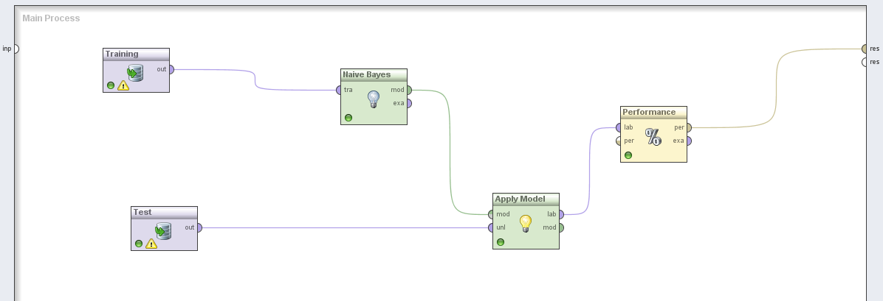
Model with all variables
We connected the training data set to the naive Bayes operator. The apply model operator compares the naive Bayes input with the input of the test data set. Eventually the performance operator measures accuracy of the model.

Slide 111
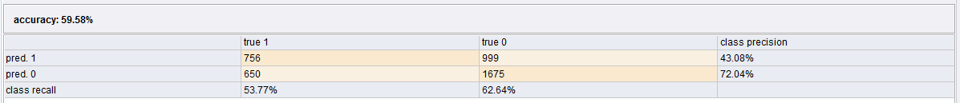
Results of model with all variables
Guessing: 50%
Sensitivity here: 53%

Slide 112
Given a randomly chosen person from the dataset, how would you classify this person?

Slide 113
There is a difference between guessing and the model. Because there is no clue for how many true ones ther are in total.

Slide 114
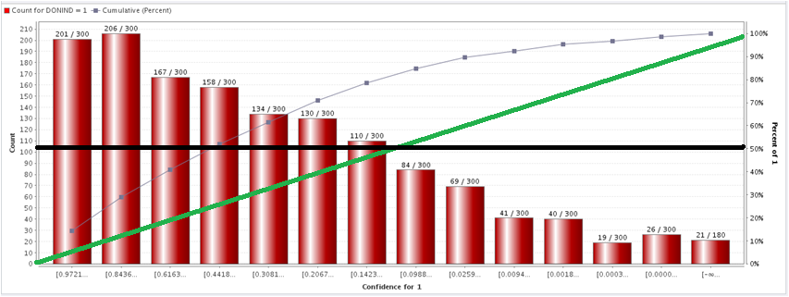
Lift chart for all variables
Y-axis: Number of donators
X-axis: Confidence

Slide 115
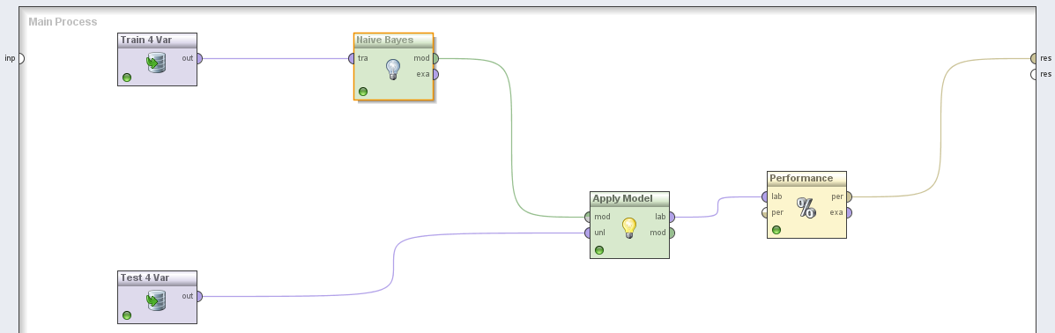
Model with 4 variables: TIMELR, TIMECL, AVGDON, LSTDON

Slide 116
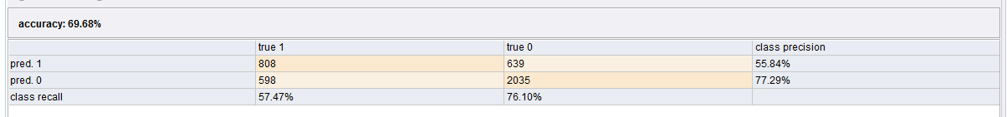
Results of model with 4 variables: TIMECL, FRQRES, AVGDON, LSTDON
Next to looking at accuracy we also look at sensitivity.
(in this case: 808/(808+598)=0.5747).
The opportunity cost of not sending a catalog to a donator is higher than the cost of sending a catalog to a non donator
Revenue if we send one extra catalog to a donator: € 18
If we don’t send this catalog we won’t receive this € 18

Slide 117
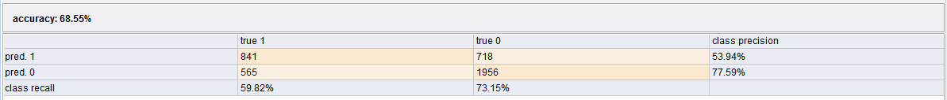
Results of model with 4 variables: TIMELR, TIMECL, AVGDON, LSTDON
The number of predicted 1, true 1 is hihger in this case namely 841 and so is the sensitivity.
Conclusion: these attributes are more usefull than the previous ones.

Slide 118
We are left with only a few variables

Slide 119
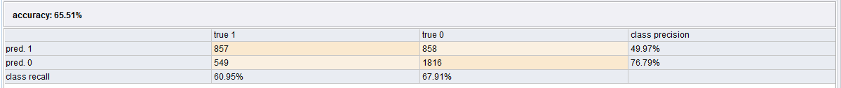
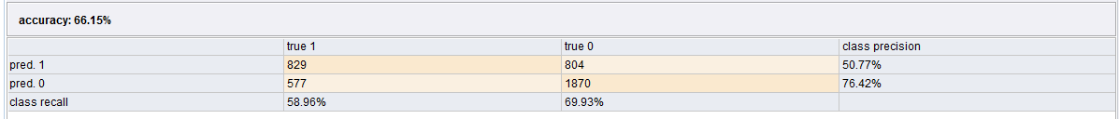
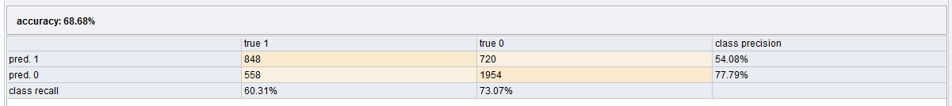
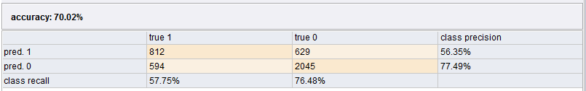
Variation 1. TIMELR, TIMECL, ANNDON
Variation 2. TIMECL, FRQRES, ANNDON
Variation 3. TIMELR, TIMECL, AVGDON
Variation 4. TIMECL, FRQRES, AVGDON

Slide 120
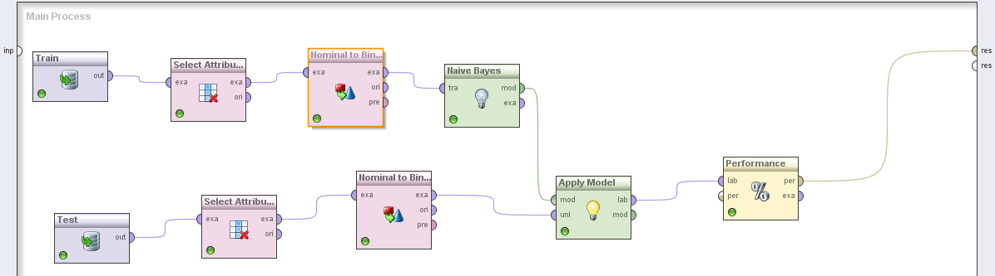
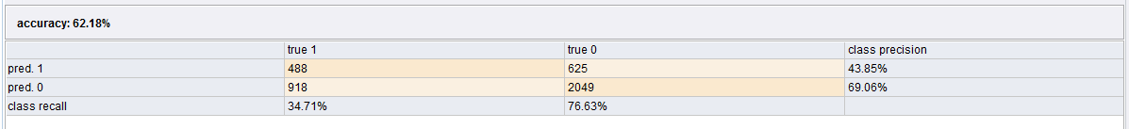
Variation 4. Variables: TIMECL, FRQRES, AVGDON with converting nominal to binominal
So converting nominal to binominal has a negative effect on the accuracy and the sensitivity.

Slide 121
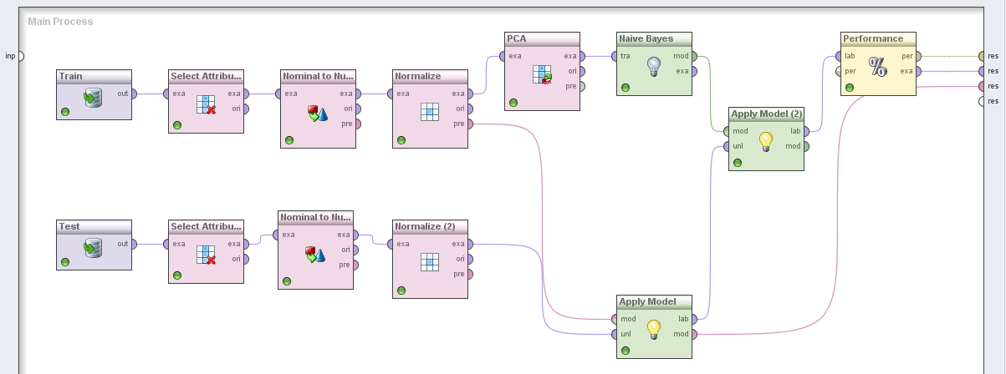
Variation 4. Model with 3 variables: TIMECL, FRQRES, AVGDON with PCA

Slide 122
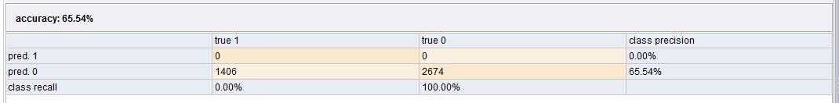
Variation 4. Results of model with 3 variables: TIMECL, FRQRES, AVGDON with PCA
The sensitivity is 0% so this result is useles. No catalogs were send. We did this for 3, 4 and 5 PCA but the result was any times equally bad.

Slide 123
4. Resulting model and final choice of variables

Slide 124
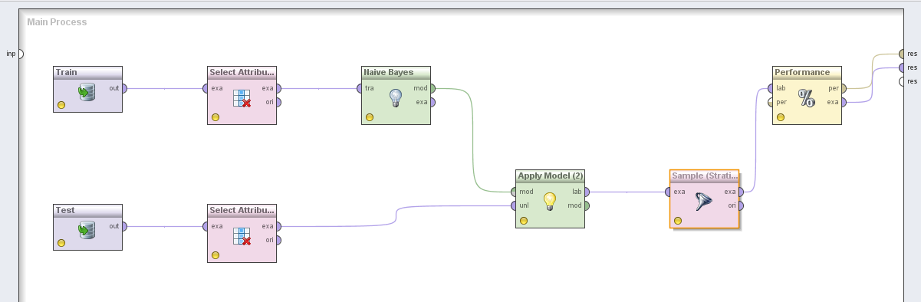
Final Model naive Bayes
Selected attributes: TIMELR, FRQRES, AVGDON

Slide 125
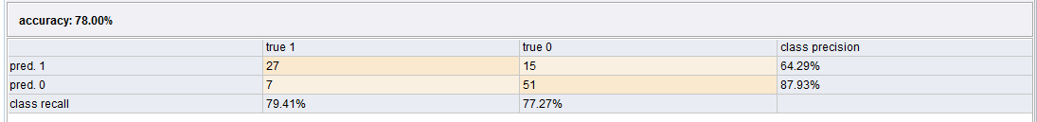
Variation 5. Results of model with 3 variables: TIMELR, FRQRES, AVGDON with sampling 100
There are just 100 records.
We improved the accuracy and the sensitivity.

Slide 126
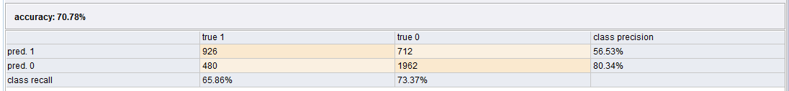
Variation 5. Results of model with 3 variables: TIMELR, FRQRES, AVGDON
These are our most accurate variables for naive Bayes. They have the highest overall accuracy and the highest sensitivity.

Slide 127
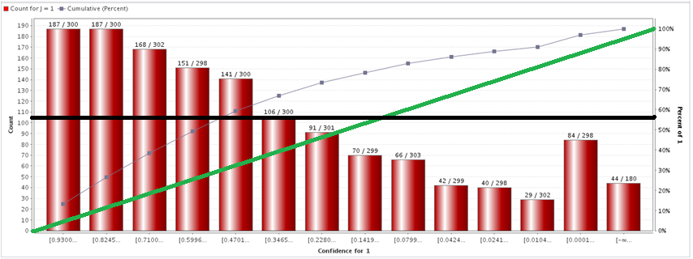
Lift chart for variables: TIMELR, FRQRES, AVGDON
Y-axis: Number of donators
X-axis: Confidence

Slide 128
Profit П of client
Profit without model:
П = €18 * 1409 – (4058 * €3,00) = € 13188
Profit with model:
П = €18 * 926 - ((926 + 712) * €3,00) = € 11754
Profit with confidence:
П = €18 * 1171 – (2415 * €3,00) = € 13833

Slide 129
5. Conclusions and recommendations for the Client

Slide 130
Use the variables: TIMELR, FRQRES, AVGDON
Send your catalogs to the predicted customers
Make profit

Slide 131
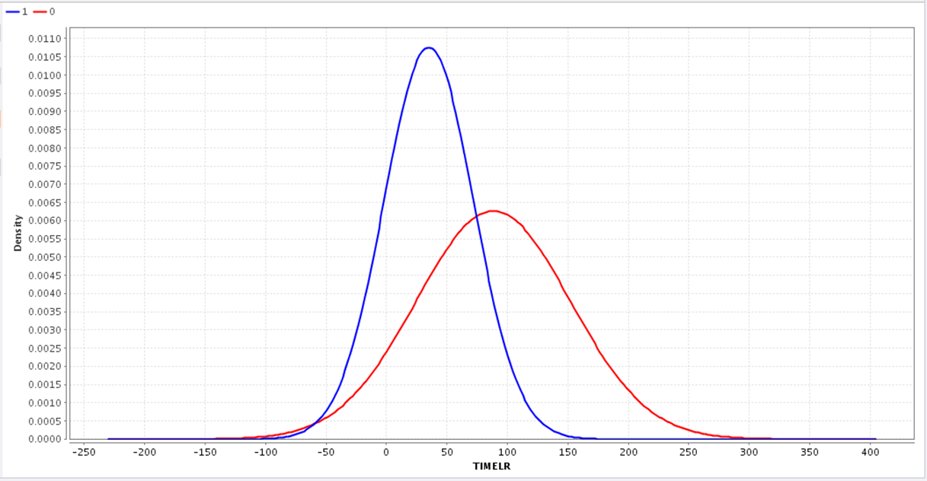
Conclusion
With showing the distribution of the attributes we saw that we can distinguish between donators and non-donators

Slide 132
Conclusions
Data reduction
We deleted the variables that had a low correlation to the outcome variable in the correlation matrix, such as MedTor and LastDon
We also tested PCA
5 PCA -96.5 %
4 PCA 92.1 %
There were a few interesting facts we found
- people usually donate once a year
- FRQRES is highly correlated with TIMELR

Slide 133
Conclusions
Trade off between accuracy, sensitivity, specificity
We used variations of models with different combinations of variables. Those variations have each a different mix of accuracy, sensitivity and specificity. We compared the outcomes en used the model with overall highest mix.
For k-nn the best combination was with 4 variables:TIMELR,FRQRES,AVGDON,TIMECL
For naive bayes the best combination was: TIMELR,FRQRES,AVGDON

Slide 134
Conclusions
In the analysis we calculated the profit by the following formula:
(probability of charity org. getting a donation)X (Average donation) – sending catalogues cost> 0
For k-nn the best method was with 4 variables and helped to earn 1500 extra
For naïve bayes the best was with 3 variables and earned 645 extra

Slide 135
Questions?

